Slide 1

Figure Skating at the 2018 Olympics
Analysis of the scores of the top 10 men singles competitors for the past two figure skating seasons

Slide 2
Background information
Skaters compete in four disciplines at the Olympic games: ladies singles, men singles, pairs and ice dancing
All disciplines have progressed technically since the start of the current Olympic cycle but the men’s event promises to be the most exciting due to the difficulty of technical elements performed
A crop of very talented men is going to compete for a place on the podium by means of a quadruple jump contest: 5 out of the 6 possible figure skating jumps are now attempted as quadruple jumps

Slide 3
Goals of the project
To predict the medal winners in the men’s event at the 2018 Olympics in Pyeongchang by analyzing data about the performance and scores over the last two (2016/2017 and 2017/2018) figure skating seasons of the skaters ranked top 10 in the world by the International Skating Union

Slide 4
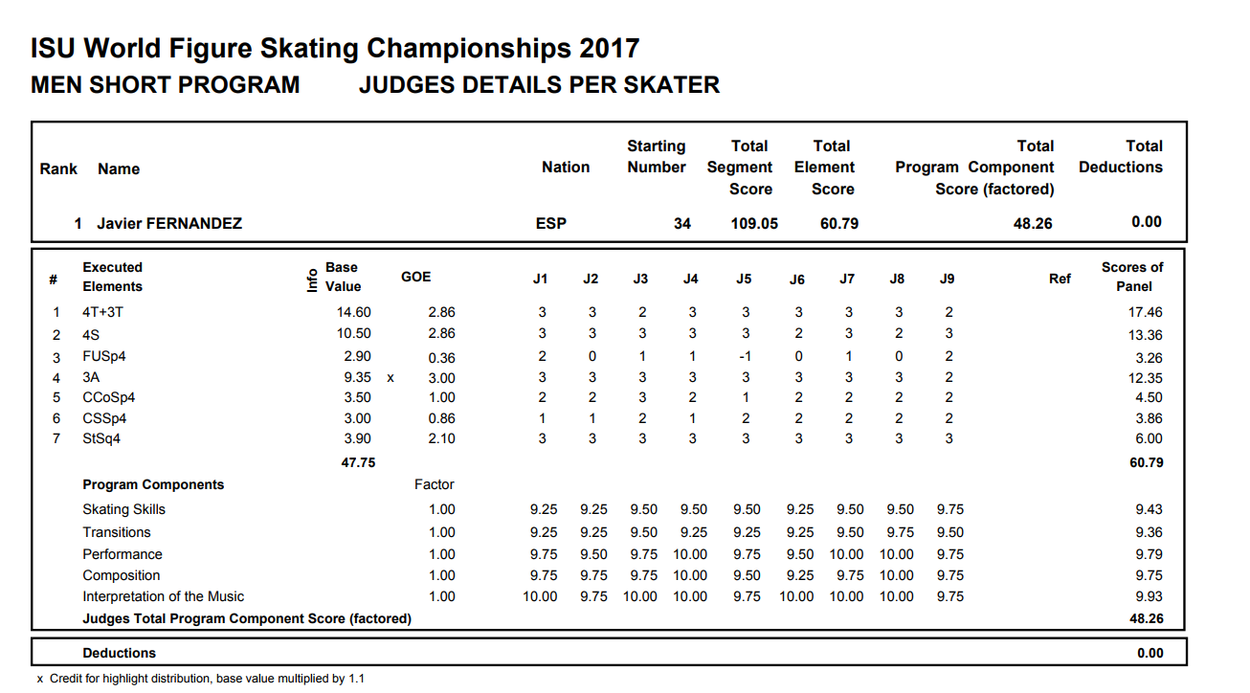
Data sources
The competition protocols published by the ISU

Slide 5
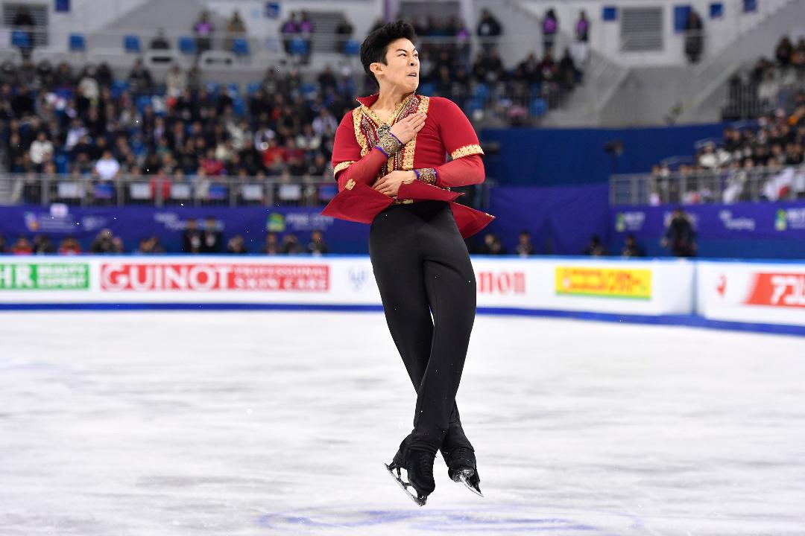
Data Sources
Scrapable ISU protocols data on: http://skatingscores.com/

Slide 6
Figure skating scoring in the men’s event
A competition consists of two segments: short (technical) program and long (free) program
TES - Technical element score: points awarded for the execution of figure skating elements (jumps, spins, step sequences)
BV – base value (point value of elements according to ISU rulebook)
GOE – grade of execution: bonus or deduction awarded by the judges based on how well the element was performed and on added difficulty
PCS – Program component scores: 1 to 10 mark in 5 categories: Skating skills, transitions, performance, composition, interpretation of the music
TSS – TES + PCS combined for one segment

Slide 7
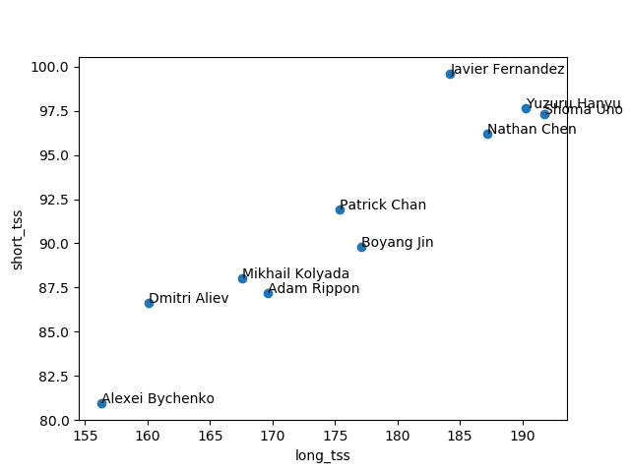
Methods: Plotting skaters data
Comparison of top 10 skaters strengths and weaknesses

Slide 8
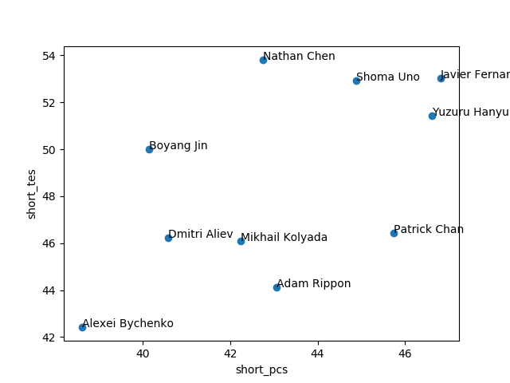
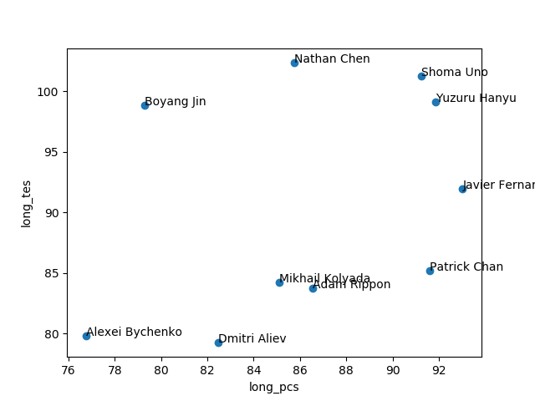

Slide 9
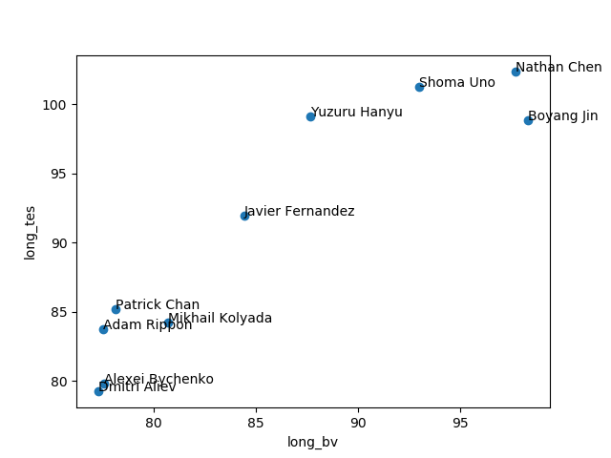

Slide 10
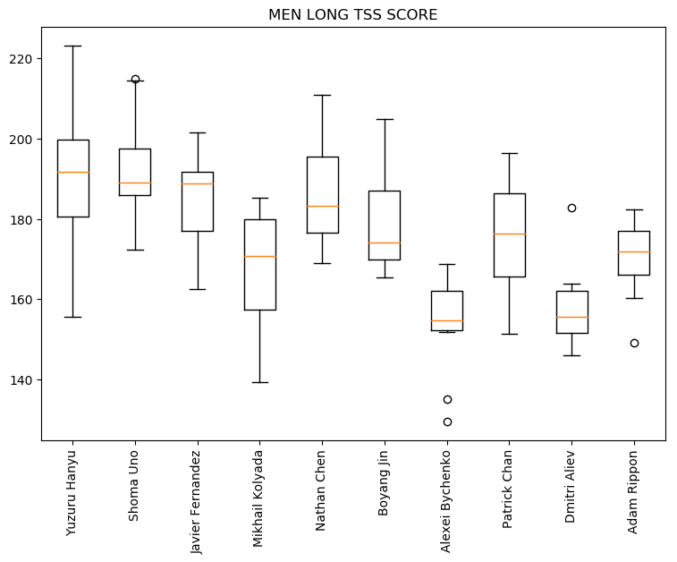
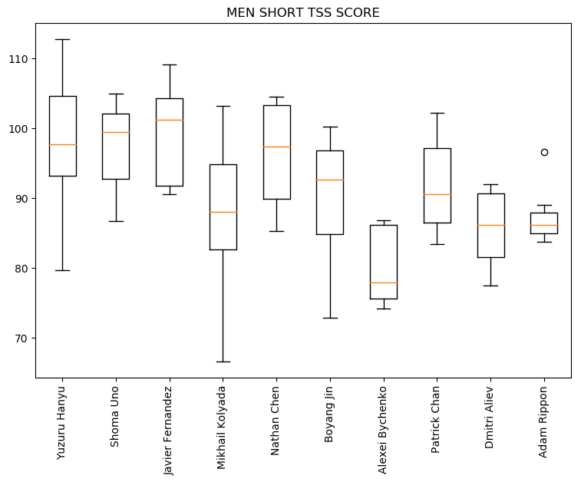
Methods: Box Plot

Slide 11
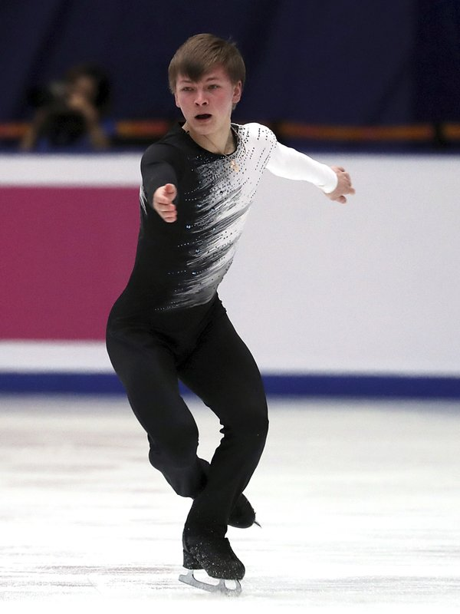
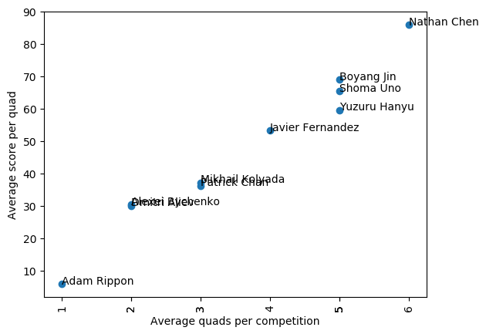
Methods: Plotting Quad Prowess

Slide 12
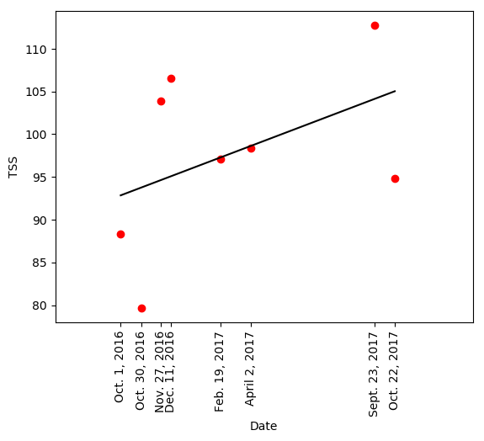
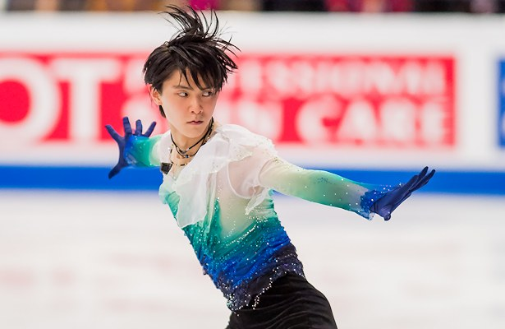
Methods: Linear Regression
Short program total segment score prediction for Yuzuru Hanyu: 108.50

Slide 13
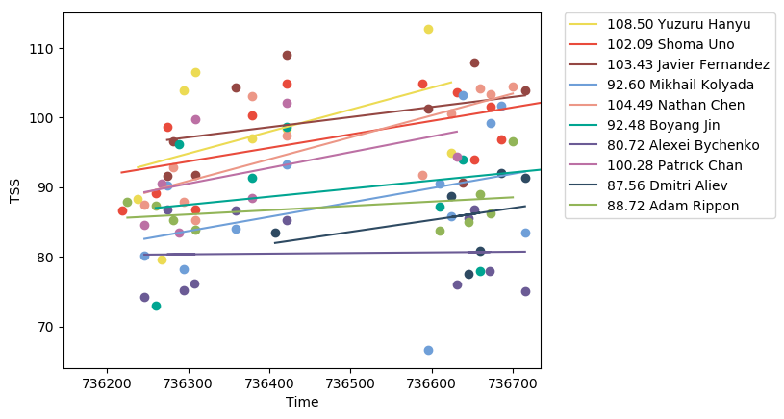
Leaders in the short program TSS
Yuzuru Hanyu (108.50), Nathan Chen (104.49), Javier Fernandez (103.43)

Slide 14
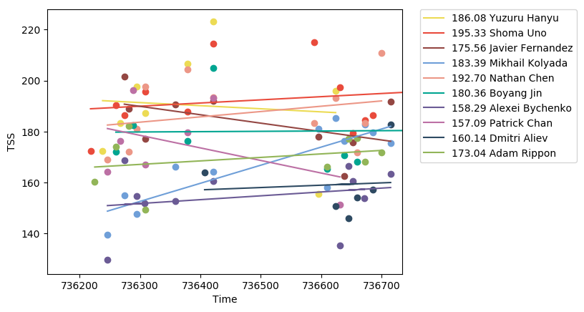
Leaders in the long program TSS
Shoma Uno (195.33), Nathan Chen (192.70), Yuzuru Hanyu (186.08)

Slide 15
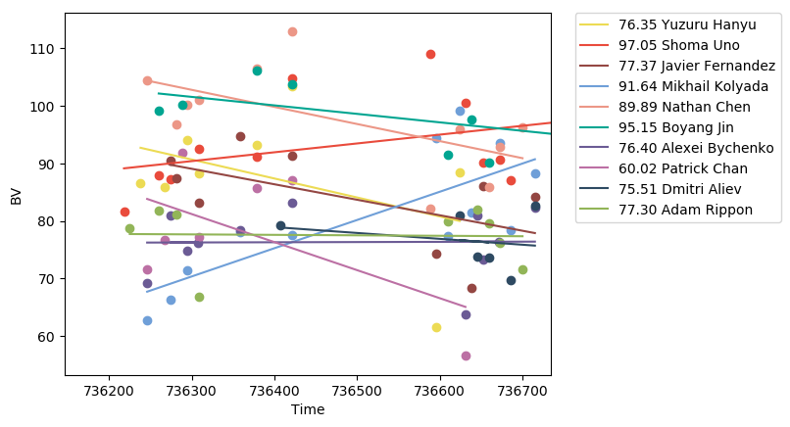
Difficulty of technical content in the long program
Top trajectories: Shoma Uno (97.05), Boyang Jin (95.15), Mikhail Kolyada (91.64)

Slide 16
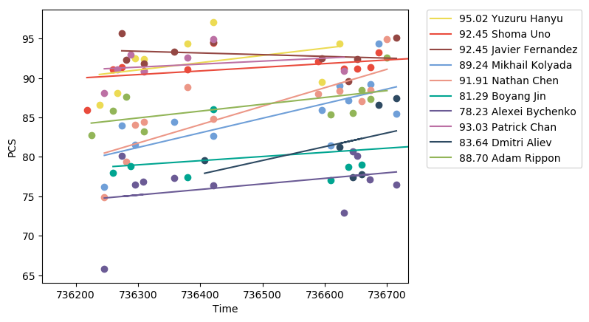
Best presentation of a long program
Best trends: Yuzuru Hanyu (95.02), Patrick Chan (93.03), Shoma Uno / Javier Fernandez (92.45)

Slide 17
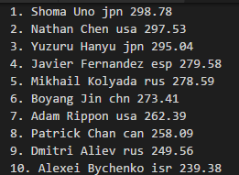
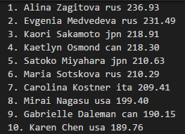
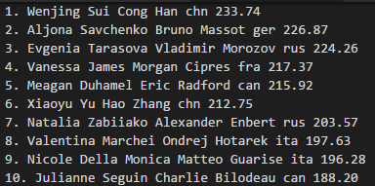
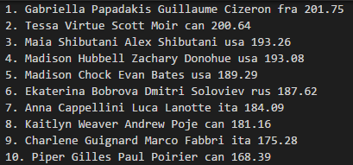
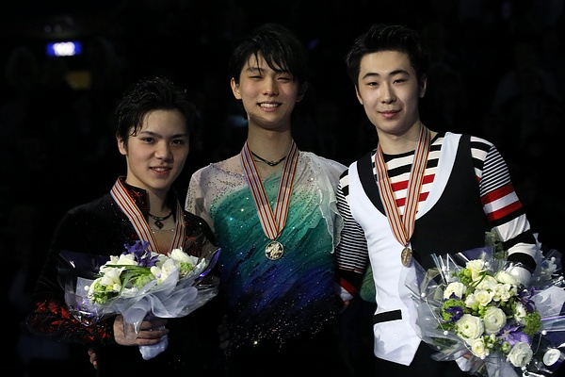
Winning formula
Short TES + Short PCS + Long TES + Long PCS
2017 World Championships podium:
Shoma Uno (silver)
Yuzuru Hanyu (gold)
Boyang Jin (bronze)

Slide 18
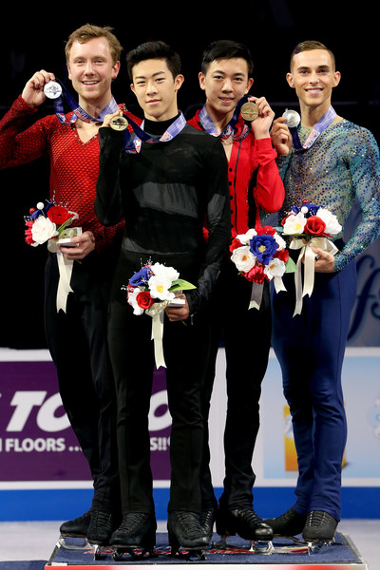
Possible applications of the project
Analysis and predictions of skaters performance can make naming to the Worlds / Olympic team easier for skating federations which want to take into account factors other than placement at Nationals
USFSA controversial passing of silver medalist Ross Miner for Worlds and Olympic team in 2018
Maximise Olympic Team Event chances

Slide 19
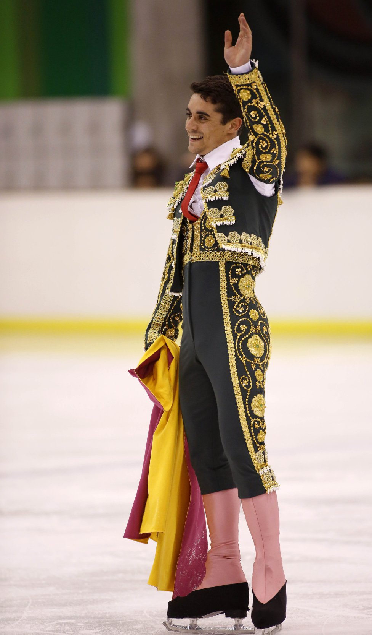
Future of the project
Lots of data to analyze:
Group skaters according to ability
% of clean performances vs performances with errors
Avg. costliness of errors (negative GOE) per skater
Moment of peaking (best performances) in the season per skater
Where each skater gains most points: jumps, spins, step sequences, presentation
Strategies for maximizing points according to skaters’ strengths
Similar analysis for ladies, pairs and ice dance

Slide 20
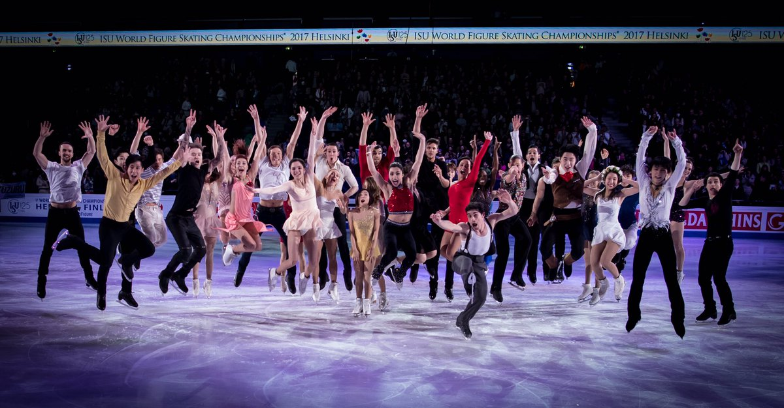
Thank you!

